Slide 1


Missing Substance Detection
TIFR Project
Project Mentors:
Prof. (Mrs.) Priya R. L.
Dr. Sharmila Sengupta
Group Members:
56 - Tanay Phatak
67 - Tanmay Thakare
71 - Gautam Wadhwani
09 - Sakshi Bhojwani
Group Number : 29
Date: 27/08/2023

Slide 2
Content
Project Objective
Assignment
Progress
OCR and Deskew
Car Color and Contour
Car Model Prediction
Future Plan

Slide 3
Project Objective
Substance: Cars
Data Source: CCTV footage
Key Identification Features: Structure, Color, Number Plate
Recent Focus: Model and Color of Cars
Notes:
Tanmay

Slide 4
Assignment
In the previous meeting, suggestions for further work were:
Number Plate Recognition using OCR.
Deskewing Number Plate images for better recognition.
Car feature extraction like color and contour.
Car Model prediction.

Slide 5
Progress
Progress so far:
Testing of image enhancement techniques.
Object detection and frame cropping.
Deskewing of number plate image for better OCR.
OCR on number plate images.
Car feature extraction like color and contour.
Car model detection.
Notes:
Mention 2 points: image overlaps and blur image similarity

Slide 6
OCR and Deskew
EasyOCR
EasyOCR is an open-source OCR library with robust language support, enabling seamless extraction of text from images in various scripts.
We tested EasyOCR on unprocessed cropped number plate images and then on deskew images.
Deskew
Performed deskewing using OpenCV functions like HoughLinesP and getRotationMatrix2D to automatically detected the amount of rotation required and perform the required processing.

Slide 7




OCR and Deskew
Deskewing Results (using OpenCV):
Original image
Deskew image
OCR Results on original image
OCR Results on deskew image

Slide 8
Car Color and Contour
Background removal
rembg library is used for background removal.
The input image data is passed to the rembg.remove function, which returns the image data with the background removed.
Color detection steps
Convert the input image to the HSV color space
Thresholding: Define color ranges for common car colors
Use contour detection to find connected components
Assume the largest contour corresponds to the car and extract its color region.
Compute the average color of the car region to represent the car's color.

Slide 9
Car Model Prediction
EfficientNet B1 Model
EfficientNet uses a technique called compound coefficient to scale up models in a simple but effective manner.
Instead of randomly scaling up width, depth or resolution, compound scaling uniformly scales each dimension with a certain fixed set of scaling coefficients.
We implemented this model for 2 datasets:
Dataset 1: It contains 16,185 images and 196 classes.
Dataset 2: It contains 4000 images of two of the popular cars (Swift and Wagonr).

Slide 10
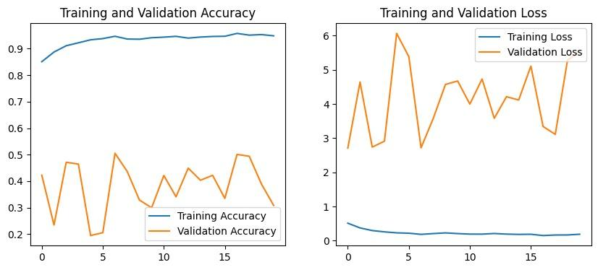
Car Model Prediction
Model performance on Dataset-1 of 196 Classes

Slide 11
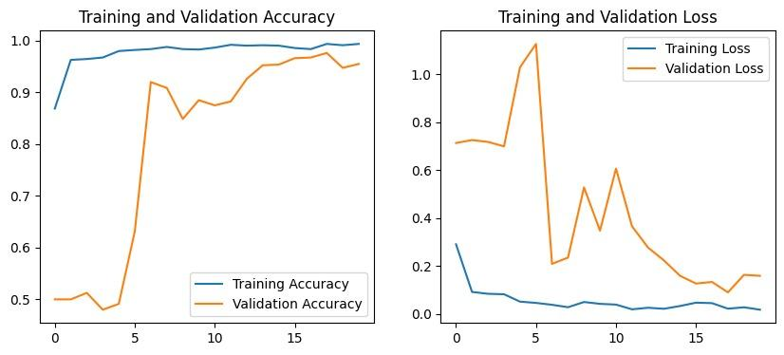
Car Model Prediction
Model performance on WagonR-Swift dataset

Slide 12
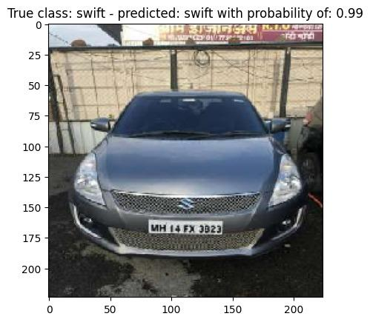
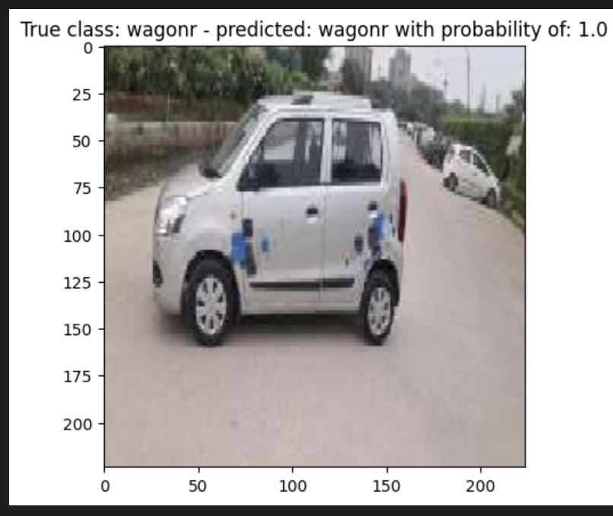
Car Model Prediction
Testing Dataset Images

Slide 13
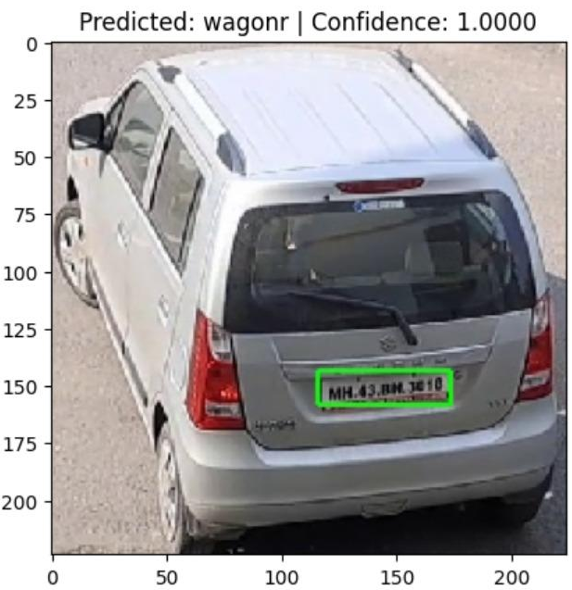
Car Model Prediction
Test on video frame

Slide 14
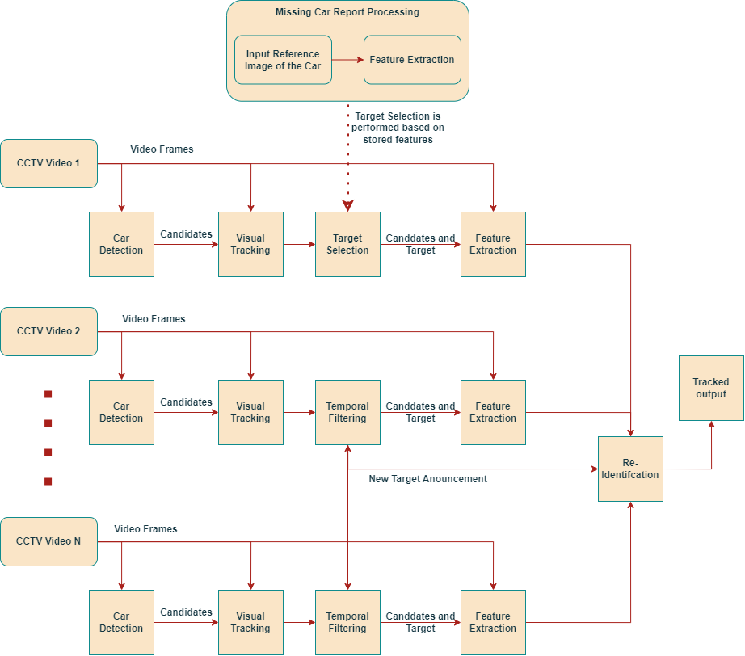

Slide 15
Future Plan
Further we plan to:
Improve feature extraction.
Perform car identification from extracted features.
Work on car tracking.

Slide 16
Thank You

